Slide 1
Intra-cluster Replication for Apache Kafka
Jun Rao

Slide 2
About myself
Engineer at LinkedIn since 2010
Worked on Apache Kafka and Cassandra
Database researcher at IBM

Slide 3
Outline
Overview of Kafka
Kafka architecture
Kafka replication design
Performance
Q/A

Slide 4
What’s Kafka
A distributed pub/sub messaging system
Used in many places
LinkedIn, Twitter, Box, FourSquare …
What do people use it for?
log aggregation
real-time event processing
monitoring
queuing

Slide 5
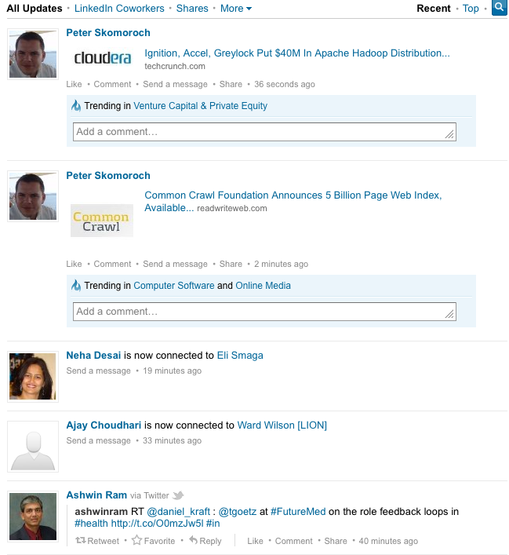
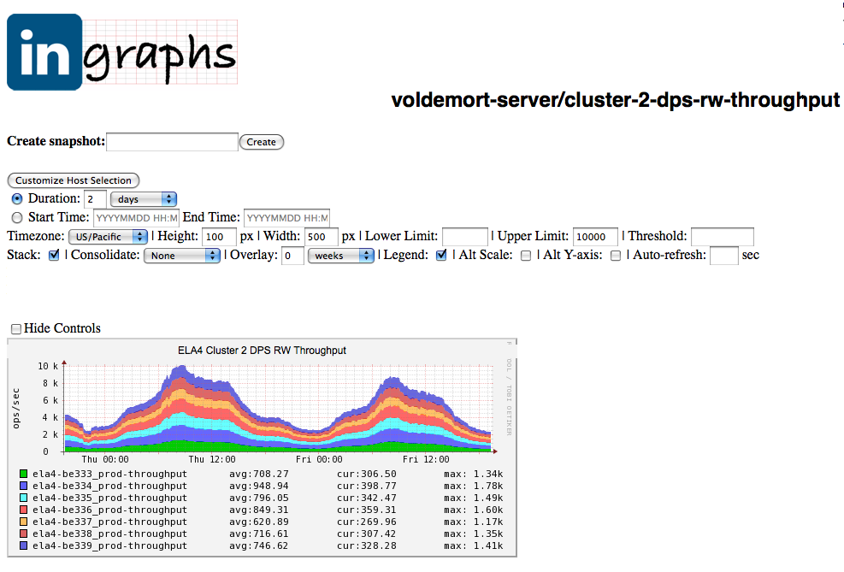
Example Kafka Apps at LinkedIn

Slide 6
Kafka Deployment at LinkedIn
Live data center
Offline data center
Live service
Live service
Live service
interactive data
(human, machine)
Monitoring
Kafka
Kafka
Kafka
Kafka
Kafka
Kafka
Hadoop
Hadoop
Hadoop
Per day stats
writes: 10+ billion messages (2+TB compressed data)
reads: 50+ billion messages

Slide 7
Kafka vs. Other Messaging Systems
Scale-out from groundup
Persistence to disks
High throughput (10s MB/sec per server)
Multi-subscription

Slide 8
Outline
Overview of Kafka
Kafka architecture
Kafka replication design
Performance
Q/A

Slide 9
Kafka Architecture
Producer
Producer
Broker
Broker
Zookeeper
Broker
Broker
Consumer
Consumer

Slide 10
Terminologies
Topic = message stream
Topic has partitions
partitions distributed to brokers
Partition has a log on disk
message persisted in log
message addressed by offset

Slide 11
API
Producer
messages = new List<KeyedMessage<K,V>>();
messages.add(new KeyedMessage(“topic1”, null, “msg1”);
send(messages);
Consumer
streams[] = Consumer.createMessageStream(“topic1”, 1);
for(message: streams[0]) {
// do something with message
}

Slide 12
Deliver High Throughput
Simple storage
Batched writes and reads
Zero-copy transfer from file to socket
Compression (batched)
logs in broker
topic1:part1
topic2:part1
msg-1
msg-2
msg-3
index
segment-1
segment-1
msg-4
msg-5
…
segment-2
segment-2
…
msg-n
read()
segment-n
segment-n
append()

Slide 13
Outline
Overview of Kafka
Kafka architecture
Kafka replication design
Performance
Q/A

Slide 14
Why Replication
Broker can go down
controlled: rolling restart for code/config push
uncontrolled: isolated broker failure
If broker down
some partitions unavailable
could be permanent data loss
Replication → higher availability and durability

Slide 15
CAP Theorem
Pick two from
consistency
availability
network partitioning

Slide 16
Kafka Replication: Pick CA
Brokers within a datacenter
i.e., network partitioning is rare
Strong consistency
replicas byte-wise identical
Highly available
typical failover time: < 10ms

Slide 17
Replicas and Layout
Partition has replicas
Replicas spread evenly among brokers
logs
logs
logs
logs
topic1-part1
topic1-part2
topic2-part1
topic2-part2
topic2-part2
topic1-part1
topic1-part2
topic2-part1
topic2-part1
topic2-part2
topic1-part1
topic1-part2
broker 1
broker 2
broker 3
broker 4

Slide 18
Maintain Strongly Consistent Replicas
One of the replicas is leader
All writes go to leader
Leader propagates writes to followers in order
Leader decides when to commit message

Slide 19
Conventional Quorum-based Commit
Wait for majority of replicas (e.g. Zookeeper)
Plus: good latency
Minus: 2f+1 replicas → tolerate f failures
ideally want to tolerate 2f failures

Slide 20
Commit Messages in Kafka
Leader maintains in-sync-replicas (ISR)
initially, all replicas in ISR
message committed if received by ISR
follower fails → dropped from ISR
leader commits using new ISR
Benefit: f replicas → tolerate f-1 failures
latency less an issue within datacenter

Slide 21
Data Flow in Replication
producer
2
ack
1
2
leader
follower
follower
3
4
commit
consumer
topic1-part1
topic1-part1
topic1-part1
broker 1
broker 2
broker 3
When producer receives ack | Latency | Durability on failures
no ack | no network delay | some data loss
wait for leader | 1 network roundtrip | a few data loss
wait for committed | 2 network roundtrips | no data loss
Only committed messages exposed to consumers
independent of ack type chosen by producer

Slide 22
Extend to Multiple Partitions
producer
leader
follower
follower
topic1-part1
topic1-part1
topic1-part1
producer
leader
follower
follower
producer
topic2-part1
topic2-part1
topic2-part1
follower
follower
leader
topic3-part1
topic3-part1
topic3-part1
broker 1
broker 2
broker 3
broker 4
Leaders are evenly spread among brokers

Slide 23
Handling Follower Failures
Leader maintains last committed offset
propagated to followers
checkpointed to disk
When follower restarts
truncate log to last committed
fetch data from leader
fully caught up → added to ISR

Slide 24
Handling Leader Failure
Use an embedded controller (inspired by Helix)
detect broker failure via Zookeeper
on leader failure: elect new leader from ISR
committed messages not lost
Leader and ISR written to Zookeeper
for controller failover
expected to change infrequently

Slide 25
Example of Replica Recovery
1. ISR = {A,B,C}; Leader A commits message m1;
L (A)
F (B)
F (C)
last committed
m1
m1
m1
m2
m2
m3
2. A fails and B is new leader; ISR = {B,C}; B commits m2, but not m3
L (A)
L (B)
F (C)
m1
m1
m1
m2
m2
m2
m3
3. B commits new messages m4, m5
L (A)
L (B)
F (C)
m1
m1
m1
m2
m2
m2
m3
m4
m4
m5
m5
4. A comes back, truncates to m1 and catches up; finally ISR = {A,B,C}
F (A)
L (B)
F (C)
F (A)
L (B)
F (C)
m1
m1
m1
m1
m1
m1
m2
m2
m2
m2
m2
m4
m4
m4
m4
m4
m5
m5
m5
m5
m5

Slide 26
Outline
Overview of Kafka
Kafka architecture
Kafka replication design
Performance
Q/A

Slide 27
Setup
3 brokers
1 topic with 1 partition
Replication factor=3
Message size = 1KB

Slide 28
Choosing btw Latency and Durability
When producer receives ack | Time to publish a message (ms) | Durability on failures
no ack | 0.29 | some data loss
wait for leader | 1.05 | a few data loss
wait for committed | 2.05 | no data loss

Slide 29
Producer Throughput

Slide 30
Consumer Throughput

Slide 31
Q/A
Kafka 0.8.0 (intra-cluster replication)
expected to be released in Mar
various performance improvements in the future
Checkout more about Kafka
http://kafka.apache.org/
Kafka meetup tonight

